Slide 1
Link-based Web Search
Vagelis Hristidis

Slide 2
Roadmap
Web Search
PageRank
PageRank Calculation using MapReduce
Personalized PageRank
Additional Material
HITS
Stability Issues
Other Applications

Slide 3
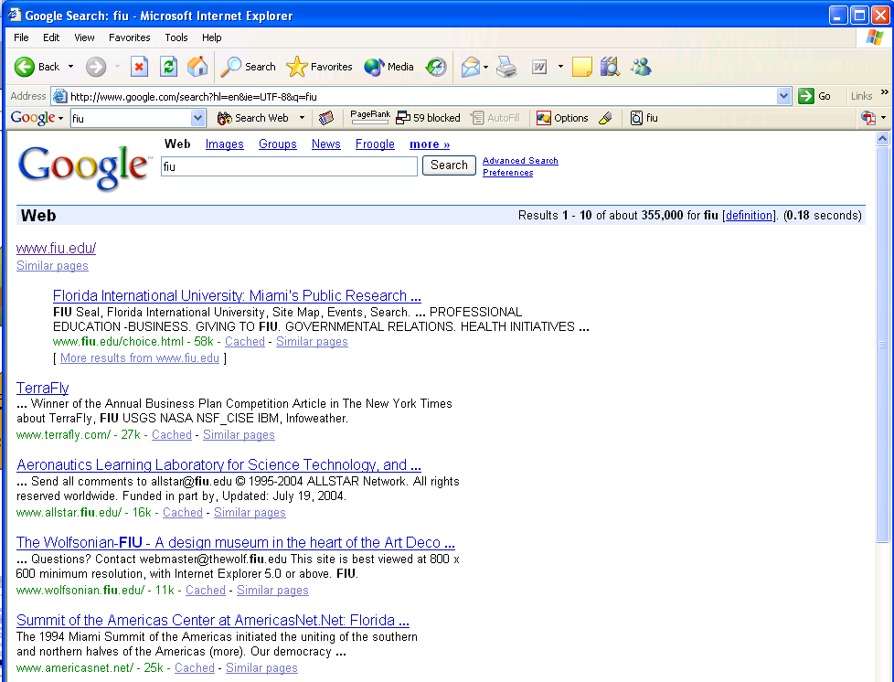
Search the Web

Slide 4
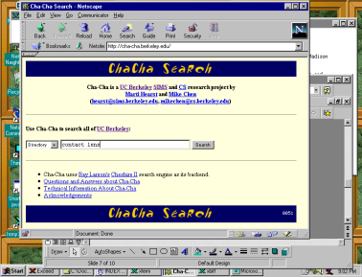
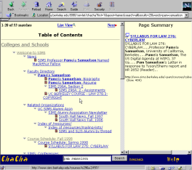
Standard Web Search Engine Architecture
Eliminate duplicates
DocIds
crawl the
web
crawler
user
query
create an
inverted
index
Inverted
index
Search
engine
servers
Show results

Slide 5
Before Google
Traditional IR Ranking
Term frequency (tf)
Inverse document frequency (idf)
Distance between keyword
….

Slide 6
Limitations of traditional IR analysis
Pages are not sufficiently self – descriptive. Usually the term “search engine” doesn’t appear on search engine web pages
Too many results!!!!
Low ranking quality.

Slide 7
Link Analysis [Kleinberg98, PageRank]
Assumptions
If the pages pointing to page p are good, then p is also a good page.
The words on the links pointing to this page are useful indicators of what this page is about. (ignore for now, less challenging)
Does it work?
Apparently, Google uses it
The link structure implies an underlying social structure in the way that pages and links are created, and it is an understanding of this social organization that can provide us the most leverage.

Slide 8
Roadmap
Web Search
PageRank
PageRank Calculation using MapReduce
Personalized PageRank
Additional Material
HITS
Stability Issues
Other Applications

Slide 9
PageRank
Make use of the link structure of the web to calculate a quality ranking (PageRank) for each web page.
Each page has unique PageRank, independent of keyword query
PageRank does NOT express relevance of page to query

Slide 10
PageRank is a Usage Simulation
“Random surfer”
Given a random URL
Clicks randomly on links
After a while gets bored and gets a new random URL
The number of visits to each page is its PageRank.

Slide 11
PageRank Calculation Intuition
PageRank of page P increases when pages with large PageRanks point to P.

Slide 12
PageRank Calculation
PR(A)=(1-d)/N + d*(PR(T1)/C(T1)+…+ PR(Tn)/C(Tn))
d: damping factor, normally this is set to 0.85.
T1, …, Tn: pages pointing to page A
PR(A): PageRank of page A.
PR(Ti): PageRank of page Ti.
C(Ti): the number of links going out of page Ti.
N: # pages
Note: d is needed due to PageRank sinks
r = (1-d)E + dMr, r: column-matrix of PRs
M: adjacency matrix of Web graph
E: Base-set column-matrix

Slide 13
Example of Calculation (1)
Page A
Page B
Page C
Page D

Slide 14
Example of Calculation (2)
Page A
1
Page B
1
1*0.85/2
1*0.85/2
1*0.85
1*0.85
Page C
1
Page D
1
1*0.85

Slide 15
Example of Calculation (3)
Page A
Page B
Page C
Page D
Page A: 0.85 (from Page C) + 0.15/4 (not transferred)
Page B: 0.425 (from Page A) + 0.15/4 (not transferred)
Page C: 0.85 (from Page D) + 0.85 (from Page B) + 0.425 (from Page A) + 0.15/4 (not transferred)
Page D: receives none, but has not transferred 0.15/4

Slide 16
Example of Calculation (5)
Page A
0.372
Page B
0.196
Page C
0.394
Page D
0.04
After 20 iterations it converges
Converges because Web data graph irreducible (strongly connected) and aperiodic
Converges fast because expander graph, that is, large separation between 1st and 2nd eigenvalue.

Slide 17
Google
Uses PageRank as one of the criteria to rank keyword query results.
Other criteria (may) include:
Term frequencies
Term proximities
Term position (title, top of page, etc)
Term characteristics (boldface, capitalized, etc)
Link analysis information
Category information
Popularity information
How can PageRank be used to answer a keyword query?

Slide 18
Roadmap
Web Search
PageRank
PageRank Calculation using MapReduce
Personalized PageRank
Additional Material
HITS
Stability Issues
Other Applications

Slide 19
PageRank using MapReduce
Each iteration is a Map-Reduce cycle
function Mapper
input <PageN, RankN> -> PageA, PageB, PageC...
begin
Nn := the number of outlinks for PageN;
for each outlink PageK
output PageK-> <PageN, RankN/Nn>
//output the outlinks for PageN.
output PageN-> PageA, PageB, PageC…
end
function Reducer
input PageK-> <PageN1, RankN1/Nn1>
<PageN2, RankN2/Nn2>
...
<PageAk, PageBk, PageCk…> //outlinks of PageK
begin
RankK := 0;
for each inlink PageNi
RankK += RankNi/Nni * beta
// output the PageK and its new Rank for the next iteration
output <PageK, RankK> -> <PageAk, PageBk, PageCk…>
end

Slide 20
Roadmap
Web Search
PageRank
PageRank Calculation using MapReduce
Personalized PageRank
Additional Material
HITS
Stability Issues
Other Applications

Slide 21
Personalized PageRank Calculation
Set B of favorite pages in the base set.
PR(A)=(1-d)/|B| + d*(PR(T1)/C(T1)+…+ PR(Tn)/C(Tn)), if A in B
PR(A)= 0 + d*(PR(T1)/C(T1)+…+ PR(Tn)/C(Tn)), if A not in B
d: damping factor, normally this is set to 0.85.
T1, …, Tn: pages pointing to page A
PR(A): PageRank of page A.
PR(Ti): PageRank of page Ti.
C(Ti): the number of links going out of page Ti.
|B|: # pages in base set

Slide 22
Additional Material

Slide 23
Roadmap
Web Search
PageRank
PageRank Calculation using MapReduce
Personalized PageRank
Additional Material
HITS
Stability Issues
Other Applications

Slide 24
Subsequent Google Ranking Algorithms
Google Panda, 2011: Human testers rated thousands of websites on quality, including design, trustworthiness, speed. Panda machine-learning algorithm uses this as training to judge other sites.
Google Penguin, 2012: Decrease score of pages with many artificial incoming links

Slide 25
HITS [Kleinberg98] Hubs & Authorities
Jon M. Kleinberg: Authoritative Sources in a Hyperlinked Environment. JACM 46(5): 604-632 (1999)
HITS ( Hypertext-Induced Topic Search) developed by Jon Kleinberg, while visiting IBM Almaden.
IBM expanded HITS into Clever.
IBM doesn't see Clever as real-time search engine. But create constantly refreshed lists of relevant pages for categories

Slide 26
Hubs & Authorities
Rank pages according to keyword query (in contrast to PageRank)

Slide 27
Hubs & Authorities
Good hub: page that points to many good authorities.
Good authority: page pointed to by many good hubs.
Given Keyword Query, assign a hub and an authoritative value to each page.
Pages with high authority are results of query

Slide 28
Hubs & Authorities Calculation : Root Set and Base Set
Using query term to collect a root set of pages from text-based search engine (AltaVista)
Root Set

Slide 29
Hubs & Authorities Calculation : Root Set and Base Set (Cont’d)
Expand root set into base set by including (up to a designated size cut-off)
all pages linked to by pages in root set
all pages that link to a page in root set
Typical base set contains roughly 1000-5000 pages
Base Set
Root Set

Slide 30
Hubs & Authorities Calculation
Iterative algorithm on Base Set: authority weights a(p), and hub weights h(p).
Set authority weights a(p) = 1, and hub weights h(p) = 1 for all p.
Repeat following two operations (and then re-normalize a and h to have unit norm):
h(v₁)
v₁
v₁
a(v₁)
h(v₂)
v₂
p
p
v₂
a(v₂)
h(v₃)
v₃
v₃
a(v₃)

Slide 31
Example: Mini Web
X
Y
Z
X
⎡
1
1
1
⎤
⎢
⎥
M
=
Y
⎢
0
0
1
⎥
⎢
⎥
⎢
⎥
Z
⎢
1
1
0
⎥
⎣
⎦
H
=
M
*
A
−
H
=
M
M
T
H
X
i
i
1
i
*
i
−
1
A
=
M
T
H
A
=
M
T
*
M
*
A
i
*
i
−
1
i
i
−
1
Z
Y

Slide 32
Example
∞
Iteration 0 1 2 3 …
X is the best hub
X
Z
Y
Z is most authoritative

Slide 33
Hubs & Authorities Calculation
Theorem (Kleinberg, 1998). The iterates a(p) and h(p) converge to the principal eigenvectors of M^{T}M and MM^{T}, where M is the adjacency matrix of the (directed) Web subgraph.

Slide 34
PageRank v.s. Authorities
PageRank
(Google)
computed for all web pages stored in the database prior to the query
computes authorities only
Trivial and fast to compute
HITS
(CLEVER)
performed on the set of retrieved web pages for each query
computes authorities and hubs
easy to compute, but real-time execution is hard

Slide 35
Roadmap
Web Search
PageRank
HITS
Stability Issues
Other Applications

Slide 36
How do we analyze algorithm stability?
General Strategy:
Start with original adjacency matrix, M
Perturb the matrix to get M*
Select k nodes in graph to add or delete
Compute distance, l(r(M),r(M*)), for some distance measure l and objective function r(M) that measures the quality of results of A somehow
Compute amount of perturbation p(Μ,Μ*) for some distance function p that measures the amount of perturbation
Evaluate the conditions, if any, where small values for p generate large values for l

Slide 37
PageRank Stability
Theoretical Result:
If original k pages to be modified do not have high overall PR scores then perturbed scores will not be far from the original

Slide 38
PageRank Stability
<p>: original PR scores (= 1st eigenvector)
<p’>: new PR scores from perturbed graph
S(<p_{k}>): sum of original PR scores for original k modified pages
d: tendency to get “bored”, damping factor
Formal Result:
||<p’> – <p>|| <= 2S(<p_{k}>) / d
Observe: Larger d and smaller S, lead to smaller differences in scores

Slide 39
HITS Stability
Stability determined by eigengap
Eigengap: difference between 1st and 2nd eigenvalues
M^{T}M for authorities, MM^{T} for hubs
If eigengap is big, HITS will be insensitive to small perturbations, vice versa if small (recall that is also converges faster)
Recall: if M^{T}M x = λx, x is eigenvector and λ is corresponding eigenvalue of M^{T}M

Slide 40
Roadmap
Web Search
PageRank
HITS
Stability Issues
Other Applications

Slide 41
PageRank Base Set
Represents where authority starts flowing from.
Used for
Personalization [WWW03]
Topic-specific PageRank [WWW02]
Keyword-specific PageRank [VLDB04]

Slide 42
Topic-Specific PageRank [Haveliwala-WWW02]
topic-specific PageRanks for each page precomputed
PageRank values of the most relevant topics used for each query.
16 topics

Slide 43
Personalized PageRank
Favorites in Base Set
Too Expensive!
[WWW03] Linearity theorem

Slide 44
ObjectRank [VLDB2004]
Paper H. Gupta et al. Index Selection for OLAP ICDE 1997
Paper J. Gray et al. Data Cube: A Relational… ICDE 1996
OLAP
Base Set
Paper C. Ho et al. Range Queries in OLAP Data Cubes SIGMOD 1997
Paper R. Agrawal et al. Modeling Multidimensional Databases ICDE 1997
ObjectRank Ranks Objects According to Probability of Reaching Result Starting from Base Set

Slide 45
ObjectRank - Example
Keyword Query: [OLAP]
Paper J. Gray et al. Data Cube: A Relational… ICDE 1996
Paper H. Gupta et al. Index Selection for OLAP ICDE 1997
1
3
Conference ICDE 1997
Paper R. Agrawal et al. Modeling Multidimensional Databases ICDE 1997
4
Paper C. Ho et al. Range Queries in OLAP Data Cubes SIGMOD 1997
2
Author R. Agrawal
Base Set
cites 0.7
authored by 0.2
contains 0.3
author of 0.2
contained 0.1

Slide 46
Efficiently Calculating PageRank
[Haveliwala-Stanford99, Y. Chen et al.-CIKM02]
Jeh and Widom [WWW03] present method to calculate PageRank values for multiple base sets, by precomputing a set of partial vectors which are used in runtime to calculate the PageRanks. The key idea is to precompute in a compact way the PageRank values for a set of hub pages.
…

Slide 47
Other Research Topics
TrustRank, Stanford, VLDB2004
Distributed PageRank Calculation, Wang, DeWitt, VLDB2004

Slide 48
MANY open problems
Automatically calibrate parameters
Performance (linear algebra and other problems)
Framework to tie tighter to application
E.g., Complaints database

Slide 49
Some References
Some slides have been taken from
www.albany.edu
http://ccc.cs.lakeheadu.ca
http://www.ics.uci.edu/~scott/linkanalysis_stability.ppt
Brin, S., & Page, L. (1998). The anatomy of a large scale hypertextual Web search engine. Computer Networks and ISDN Systems, 30(1-7), 107-117.
Kleinberg, J. (1999). Authoritative sources in a hyperlinked environment. Journal of the ACM, 46(5), 604-632.
http://www.db.ucsd.edu/objectrank/

